Slide 1
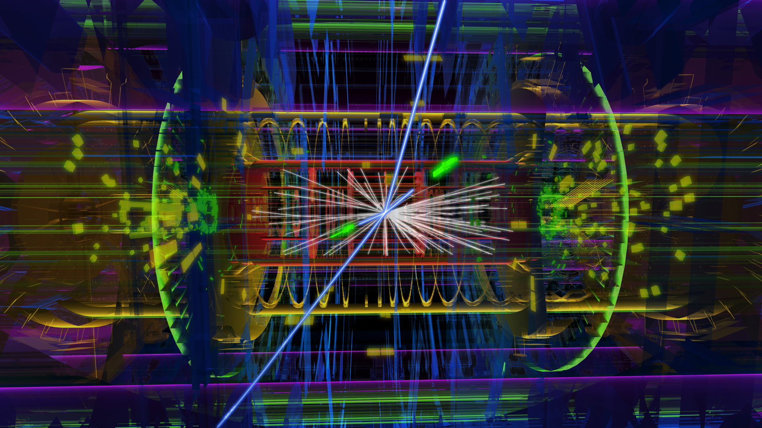
Searching for Supersymmetry at the Large Hadron Collider: Quo Vadis?
Zinonas Zinonos
MPI für Physik, München
MLL Kolloquium, TUM – June 1st, 2017

Slide 2
Overview
Searching for Supersymmetry at LHC
Prospects for supersymmetric searches at LHC
Motivation for Supersymmetry

Slide 3
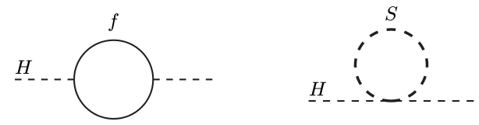
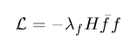
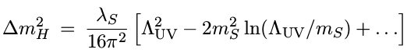
Standard Model
Higgs discovery in July 2012: a triumph for the SM of elementary particles!
A new particle consistent with the Higgs boson properties - a very non–trivial check of the SM
But is SM the “theory of everything”? No!
“Esthetical” problems with multiple and arbitrary parameters; gauge coupling unification do not meet a high scale
“Experimental” problems as it does not explain all seen phenomena; ν masses, dark matter, baryon asymmetry in universe, …
“Theory” problems – Naturalness;
Aesthetic hierarchy problem: Large energy gap between the Planck scale (10¹⁶ TeV) and Electroweak + Strong mass scale
Technical hierarchy problem: m_{H} not stable against high energy scales
Quadratic divergences due to quantum loop corrections can be canceled out via fine-tuning or symmetries…

Slide 4
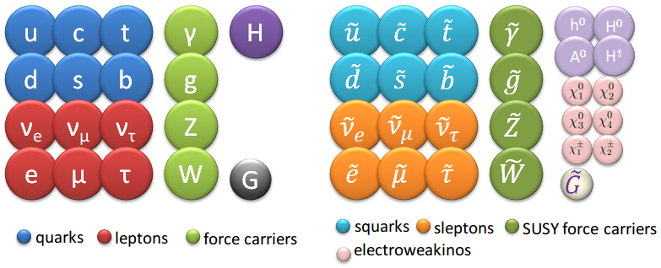
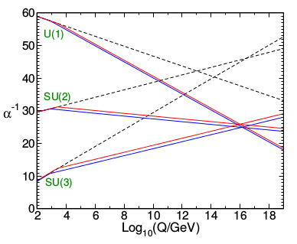
Supersymmetry
Most compelling possible extension of SM
Generalization of the space-time symmetries which transforms fermions into bosons and vice versa (Δs=½ )
No unnatural fine-tuning of the parameters of the fundamental theory at the Planck scale ⇒ elegant solution to the naturalness problem
Provides a framework for the unification of particle physics and gravity at the Planck energy scale
Predicts that gauge couplings, as measured experimentally at the electroweak scale, unify near the Planck scale (“GUT scale”)
Provides a dark matter candidate
Exact symmetry of nature? Particles and super-partners would be mass-degenerate, but not yet observed → broken symmetry
SM
MSSM
Evolution of the inverse gauge couplings α⁻¹_{a}(Q)

Slide 5

MSSM Structure
Minimal Supersymmetric extension of Standard Model
superpartners lie below at a-few-TeV energy scale
low-energy SUSY is motivated by the possible cancellation of quadratic divergences in radiative corrections to m_{H}
Canonical signature of conventional RPC SUSY scenarios is missing (transverse) energies due to the escape of the LSP (behaves like a heavy neutrino )
LSP is assumed to be a weakly interacting massive particle (WIMP) – DM candidate
SUSY phenomenology in scattering processes crucially depends on whether the R-parity multiplicative quantum number is conserved (proton stability)
R = (-1)^{3(B-L) + 2S} B = baryon, L = lepton number
R-parity invariance implies:
sparticles must be pair-produced
lightest supersymmetric particle (LSP) is absolutely stable
LSP eventually produced at the end of decay chain
Where these particles
can be
hiding?

Slide 6
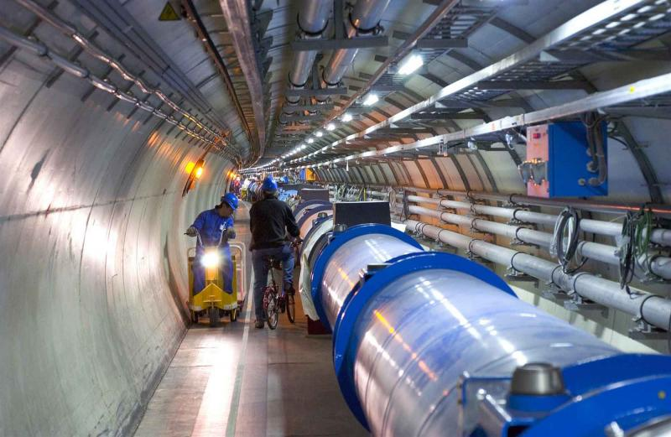
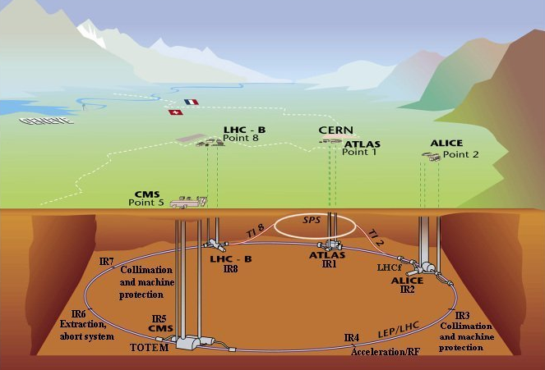
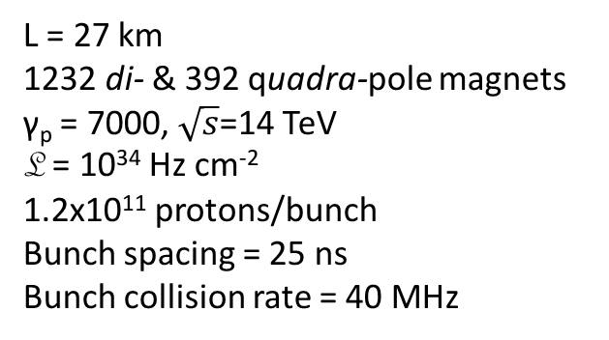
The Large Hadron Collider
World's largest and most powerful particle collider & cryogenic facility ever built
L = 27 km
1232 di- & 392 quadra-pole magnets
γ_{p} = 7000, $\sqrt{s}$=14 TeV
L = 10³⁴ Hz cm⁻²
1.2x10¹¹ protons/bunch
Bunch spacing = 25 ns
Bunch collision rate = 40 MHz
Particle physicists’ tool to probe physics at the TeV scale

Slide 7
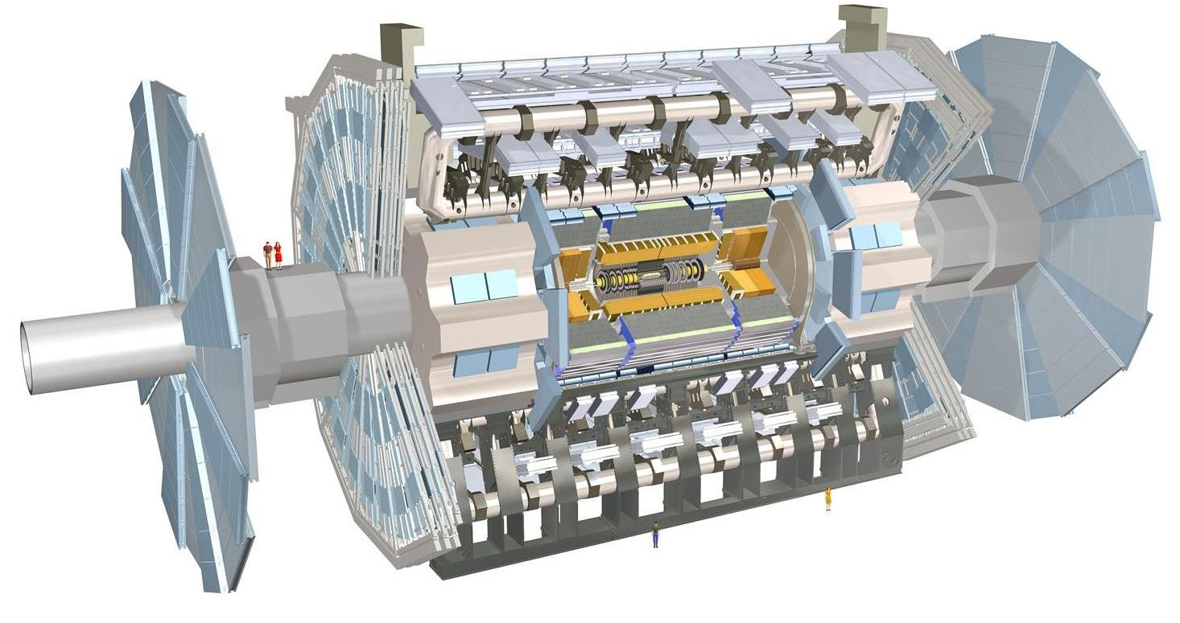
The ATLAS Detector
Muon Spectrometer
Precision Tracking
Trigger Chambers
Calorimeters
LAr EM
LAr Hadronic
End-Cap &
Forward
Tile sampling
HAD calorimeter
Inner Tracker
Silicon pixel detector
Semiconductor tracker
Transition radiation tracker
Superconducting
Magnets
multi-purpose - 4π hermetic
forward-backward
symmetric cylindrical symmetry
Solenoid 2T axial
Toroid Air-core 8-coil 4T

Slide 8
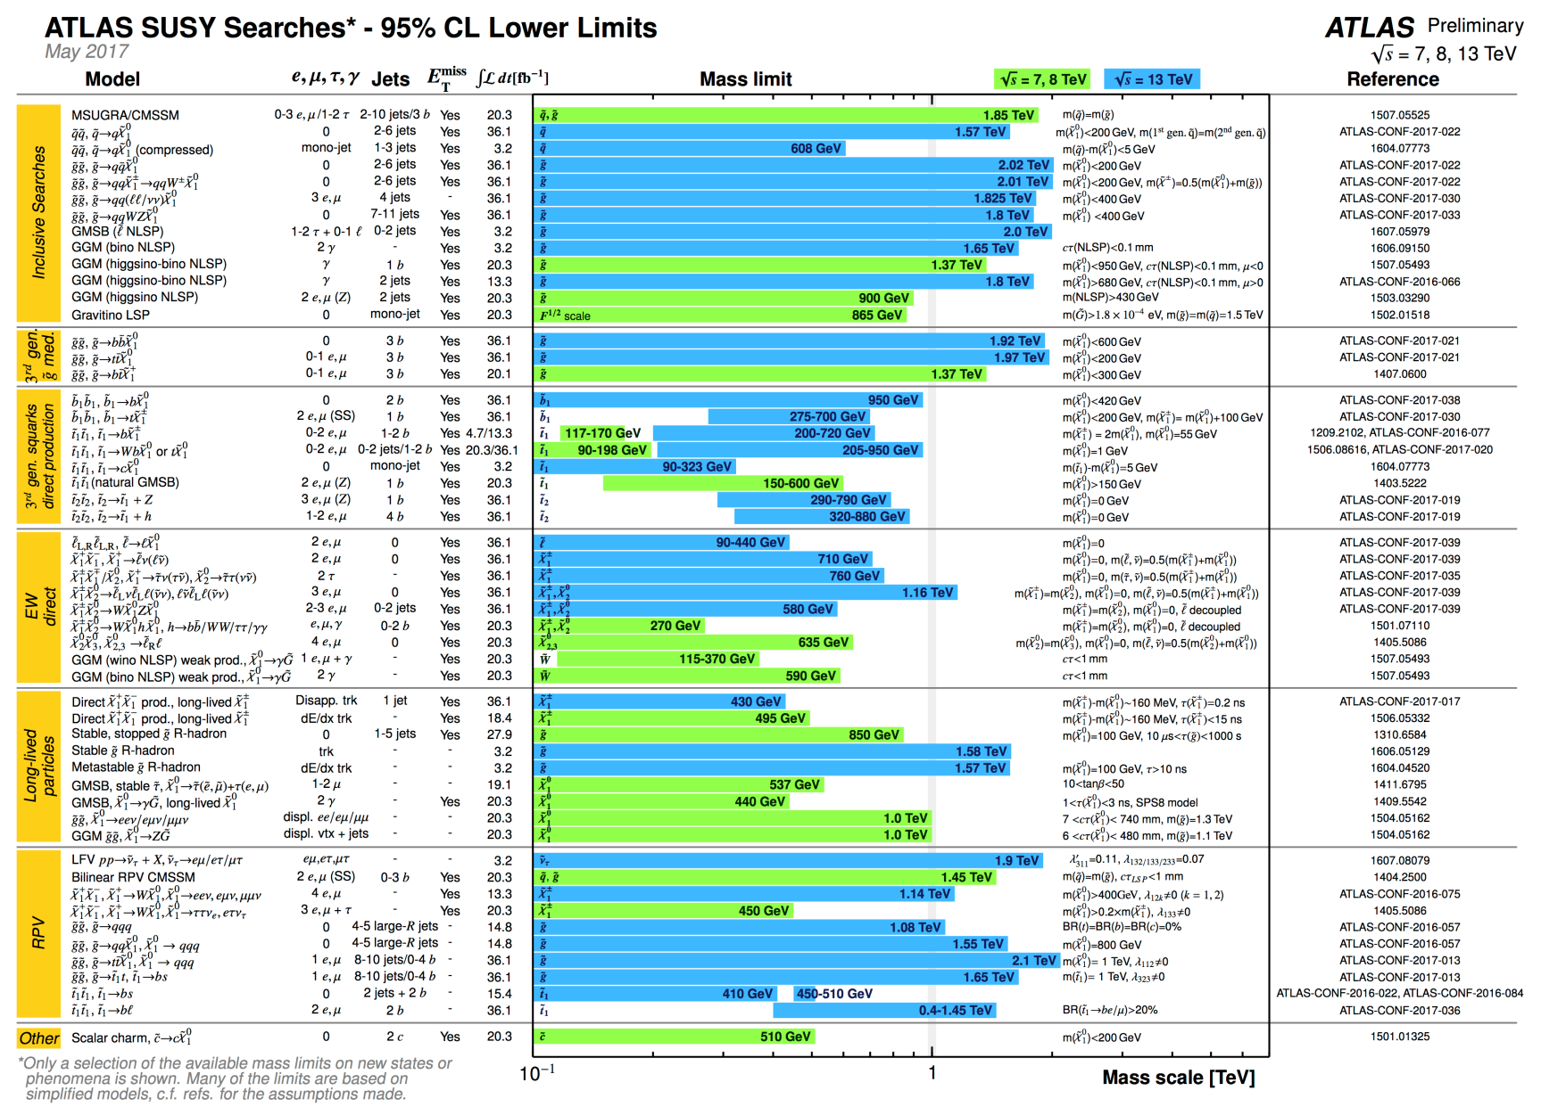
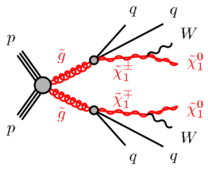
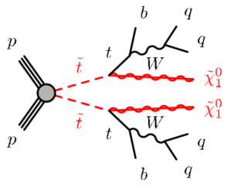
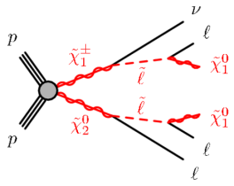
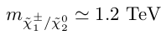
Landscape of SUSY searches
Experimental searches push the SUSY scale M_{SUSY} ≥ O(1 TeV)!

Slide 9
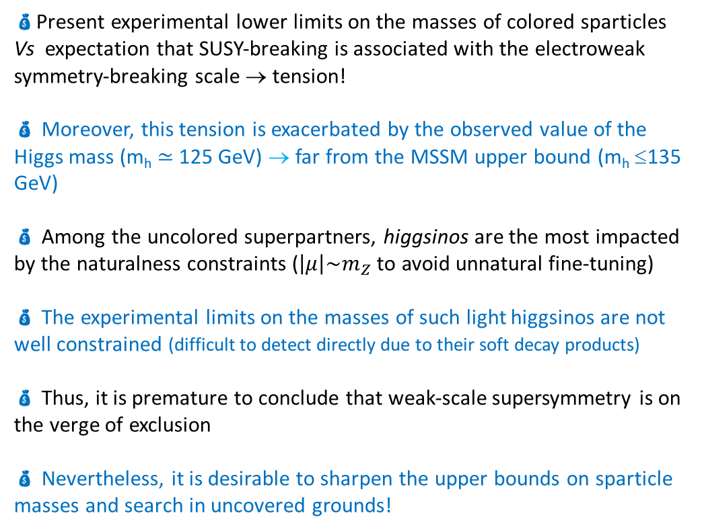
In the Quest of SUSY
4-Lepton searches
RPV
RPC (higgsinos)
Strong Production
Electroweak Production
Present experimental lower limits on the masses of colored sparticles Vs expectation that SUSY-breaking is associated with the electroweak symmetry-breaking scale → tension!
 Moreover, this tension is exacerbated by the observed value of the Higgs mass (m_{h} ≃ 125 GeV) → far from the MSSM upper bound (m_{h} ≤135 GeV)
 Among the uncolored superpartners, higgsinos are the most impacted by the naturalness constraints ($\left|μ\right|\sim m_{Z}$ to avoid unnatural fine-tuning)
 The experimental limits on the masses of such light higgsinos are not well constrained (difficult to detect directly due to their soft decay products)
 Thus, it is premature to conclude that weak-scale supersymmetry is on the verge of exclusion
 Nevertheless, it is desirable to sharpen the upper bounds on sparticle masses and search in uncovered grounds!
Electroweak Production
Stau searches
direct
staus
indirect
staus
…
τ_{had}τ_{had}
τ_{lep}τ_{had}
Still many uncovered areas and models still without sensitivity →intensify search efforts!

Slide 10
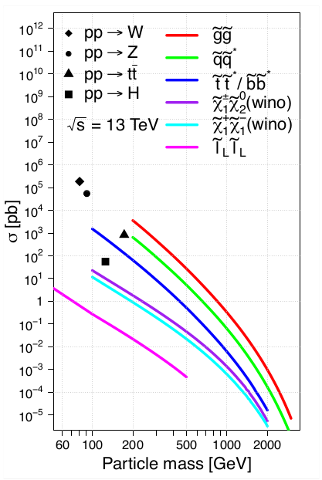
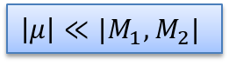
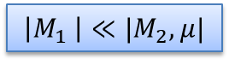
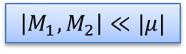
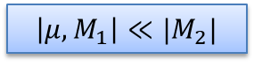
Signal Phenomenology in a Nutshell
sparticle masses
mass degenerate
triplet
strong production
bino LSP
wino NLSP
higgsino NLSP
bino/higgsino mix
$$\left|M_{1} \right|≪{|M}_{2},μ|$$
$\left|μ\right|≪{|M_{1},M}_{2}|$
$$\left|M_{1},M_{2}\right|≪|μ|$$
$$\left|μ,M_{1}\right|≪{|M}_{2}|$$
In the EW sector, the mass eigenstates and mixing angles depend principally on the parameters:
SUSY-concerving higgsino-mixing mass μ
gaugino Majorana masses M₁ (bino), M₂ (wino)
EW production
Composition-dependent cross-sections

Slide 11
signatures with 4 leptons

Slide 12
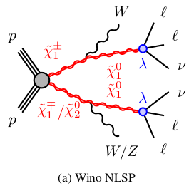
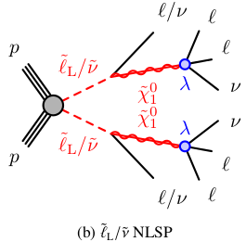
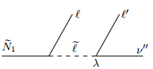
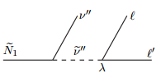
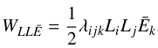
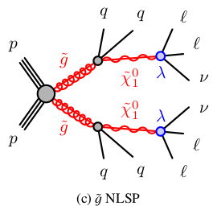
RPV Scenarios
Simplified models of with RPC cascade & RPV decay scenarios where the LSP is a bino-like & prompt 10 ≤ m_{LSP} ≤ m_{NLSP} -10 GeV
The RPV LSP decay is mediated by the lepton-number-violating super-potential term:
m-degenerate wino-like NLSP
Yukawa coupling
Lepton singlet
super-field
m-degenerate
Lepton SU(2)-doublet super-field
Two extreme scenarios of the Eare considered with different sensitivity
LLE12k: e,μ - enriched
LLEi33: τ-favored
gluino pair-produced NLSP

Slide 13
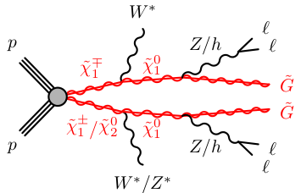
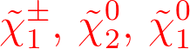
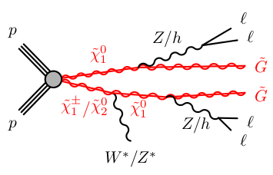
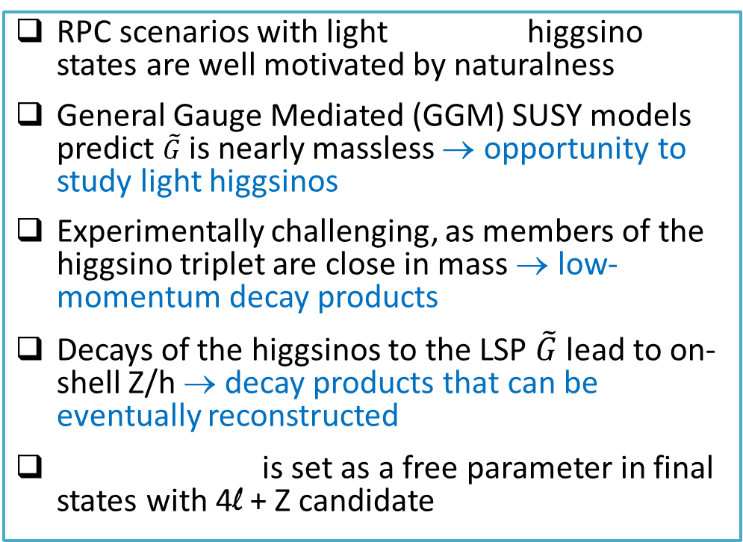
RPC Scenarios
RPC scenarios with light higgsino states are well motivated by naturalness
General Gauge Mediated (GGM) SUSY models predict $\tilde{G}$ is nearly massless → opportunity to study light higgsinos
Experimentally challenging, as members of the higgsino triplet are close in mass → low-momentum decay products
Decays of the higgsinos to the LSP $\tilde{G}$ lead to on-shell Z/h → decay products that can be eventually reconstructed
is set as a free parameter in final states with 4l + Z candidate
off-shell
gauge bosons
on-shell
Z/h

Slide 14
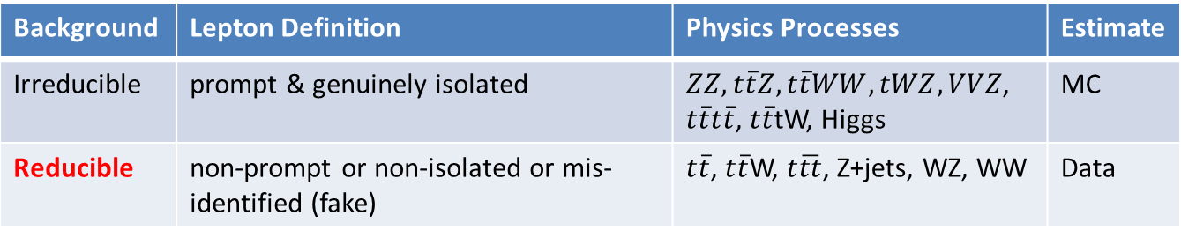
Search Regions & Backgrounds
SR0A
≥ 4 light charged leptons
SR0B
≥ 4 light charged leptons
RPV LLE12k
General search
low meff cut
high meff cut
SR0C
≥ 4 light charged leptons
SR0D
≥ 4 light charged leptons
higgsino GGM
higgsino GGM
low MET cut
high MET cut
SR1
3 light charged leptons, ≥ 1 τ
SR2
2 light charged leptons, ≥ 2 τ
RPV LLEi33
RPV LLEi33
Background | Lepton Definition | Physics Processes | Estimate
Irreducible | prompt & genuinely isolated | $ZZ, t\overline{t}Z,t\overline{t}WW,tWZ, VVZ$, $t\overline{t}t\overline{t}$, $t\overline{t}$tW, Higgs | MC
Reducible | non-prompt or non-isolated or mis-identified (fake) | $t\overline{t}$, $t\overline{t}$W, $t\overline{tt}$, Z+jets, WZ, WW | Data

Slide 15
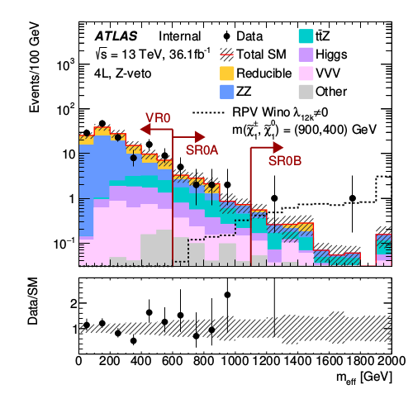
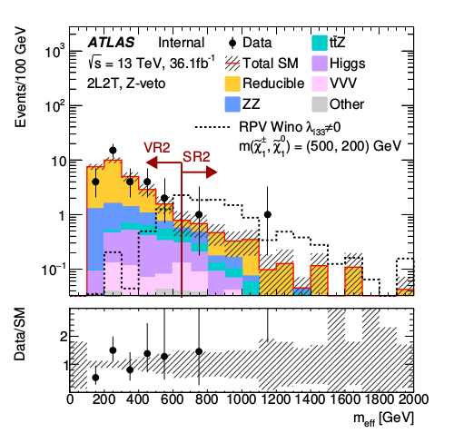
4-Lepton Results
m_{eff}
SR0A & SR0B
m_{eff}
SR2
Observations are consistent with the SM expectations within a local significance of at most 2.3σ

Slide 16
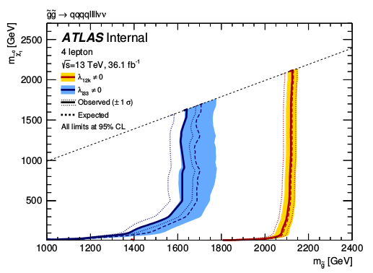
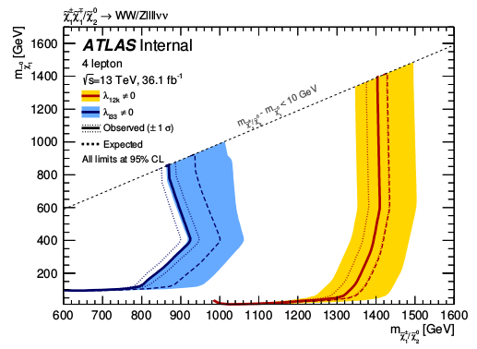
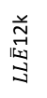
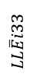
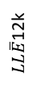
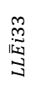
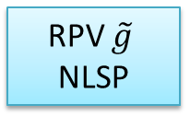
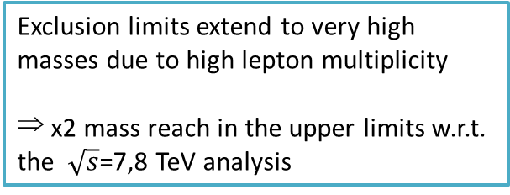
Results Interpretation
RPV $\tilde{g}$
NLSP
RPV Wino NLSP
$LL\overline{E}$12k
$LL\overline{E}$12k
$$LL\overline{E}i33$$
$$LL\overline{E}i33$$
Exclusion limits extend to very high masses due to high lepton multiplicity
⇒ x2 mass reach in the upper limits w.r.t. the $\sqrt{s}$=7,8 TeV analysis
Signal model excluded at 95% CL (CL_{s} of the s+b hypothesis < 0.05)
Q: Indications that our endeavor in searching for SUSY is coming to an end?

Slide 17
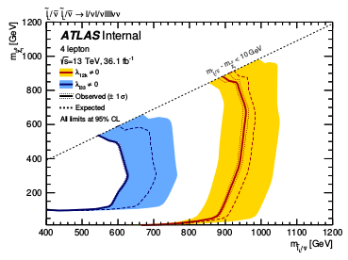
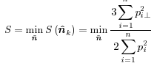
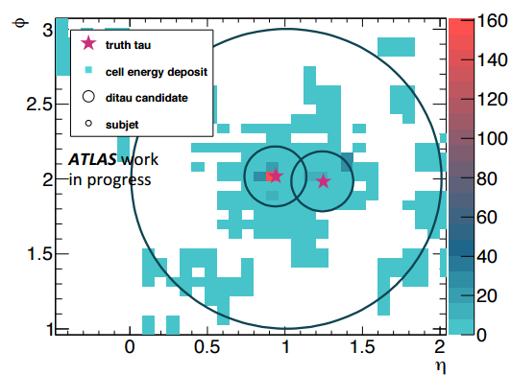
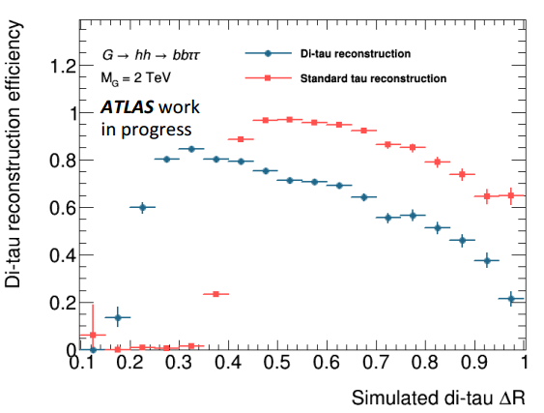
Future Developments
RPV NLSP
kinematic boundary
acceptance gradient
2. Constrain systematic uncertainties by adopting
data-driven techniques for background estimates
cross-section gradient
2. Exploit global event characteristics (energy dispersal) using “event shape variables”, such as Fox-Wolfram moments,
Thrust, Sphericity ….
Sensitivity enhancement - Di-tau reco to recover close by/collimated hadronic τ’s
3. Machine learning: optimize the S/B separation based on robust multivariate classification algorithms (Boosted Decision Trees, NN, Deep ML, …)
tauRec
blind
region
ΔR

Slide 18
electroweak production & staus

Slide 19
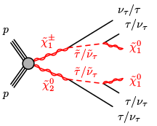
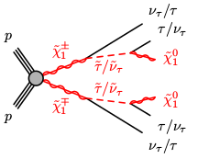
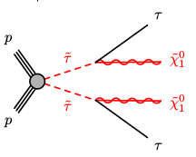
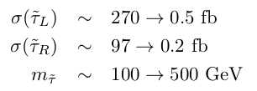


Stau searches
→ Mass of lightest 3rd-generation sparticles, ${\tilde{\text{χ}}}^{±}$ and ${\tilde{\text{χ}}}^{0}$should be ~O(100 GeV)
- arguments suggested by Naturalness to protect m_{H} from quadratically divergent quantum corrections
→ Models with light $\tilde{τ}$ are consistent with current matter data from cosmological observations
→ In the context of pMSSM, EW production of direct $\tilde{τ}$’s becomes dominant if ${\tilde{\text{χ}}}^{±}$ and ${\tilde{\text{χ}}}^{0}$are heavy ( is bino-like):
Simplified model with
stau mixing

Slide 20







Current Results
ATLAS-CONF-2017-035
Search for wino-like -pairs and -association (combined) – decay into on-shell $\tilde{τ}$-pairs
Final states with…
Hadronicaly decaying τ’s
Significant E_{T}^{miss}
Low jet activity – only ISR jets
Assumptions:
● m(NLSP) = 600 GeV
● LSP is massless
ATLAS limits
at $\sqrt{s}$=8 TeV
LEP limits
LHC limits supersede LEP results but…

Slide 21







Direct stau
Run1 analysis
Best observed upper limit at ${\tilde{τ}}_{R}$ mass of ~109 GeV &
Upper limits at 95% CL on σ_{signal} for the associated production ${\tilde{τ}}_{L}$ and ${\tilde{τ}}_{R}$ set by LEP and LHC
Low sensitivity due to the low cross-section
Run1 analysis: consider only tau hadronic final states
Method of estimating the tau-jet fakes background is statistically limited
LEP exclusion
m($\tilde{τ}$) ≳ 90 GeV
Any ideas to improve sensitivity?

Slide 22


Prospects for the direct stau search
τ_{lep}τ_{lep}
τ_{lep}τ_{had}
τ_{had}τ_{had}
Add the τ_{lep}τ_{had} final state!
highly QCD-jet-clean topology
use a genuine data-driven technique for the jet-to-tau fake background calculation
maximize acceptance by exploiting lepton triggers
Q: More sophisticated approaches?
Introduce a set of experimental observables which can be used to increase sensitivity to compressed scenarios ($m_{NLSP}−m_{LSP}→0$)?
2. Multivariate classification methods to maximize the S/B separation
typical examples: BDTs or NNs

Slide 23


Recursive Jigsaw Reconstruction
A method to decompose events into a basis of sensitive variables
A decay tree is imposed on the analysis of each event
capture the kinematic features specific to the signal topology under study
Define two hemispheres consisting of visible and invisible parts
Recursively boost from detector basis to each decay reference frame
Rather than obtaining one observable, get a complete basis of useful physical observables: angles, energies, invariant masses, …
RJ technique can substantially bring sensitivity to the compressed region - extra separation power in rejecting background events with signal-like behavior
PhysRevD.95.035031

Slide 24






Novelties in Reconstruction
Gain sensitivity in the analyses by improving the reconstruction!
1-track
BDT Tight
1. Boosted Regression Tree-based calibration
x2 improvement of the τhad energy resolution in the region p_{T} < 100 GeV
2. Improved tau ID
+20% jet-to-tau fake background rejection!
ATLAS-CONF-2017-029
τ ID
τ decay modes
Resolution
3. Tau Particle Flow
access to the tau decay modes → observables to distinguish S from B
major improvement in the tau energy resolution → more accurately-defined observables
$$\sqrt{s}=8TeV$$
$$\sqrt{s}=13TeV$$

Slide 25
Synopsis
Culmination of work and plethora of analyses searching for SUSY at LHC!
The absence of any observation of new phenomena place significant constraints on SUSY parameter space
However, depending on the assumptions made of the underlying SUSY spectrum these limits can also weaken
Still a lot to be done to rule out SUSY below the 1 TeV scale – exploration of SUSY today is more plausible than ever
Apart from pushing the sensitivity of LHC searches to higher mass scales, further data will also help to reduce holes and gaps that are left behind in today’s SUSY limits…
Stay tuned for more exciting results with the forthcoming LHC data!

Slide 26
Acknowledgements
Thank you for your attention!
Special thanks to Prof. Dr. Hubert Kroha

Slide 27
Backup

Slide 28






Data Taking & Performance
LHC Delivered 42.7 fb⁻¹
$$\sqrt{s}=13TeV$$
ATLAS Recorded 39.5 fb⁻¹
Good for Physics 36.1 fb⁻¹
Flavor tagging x2 better fake rejection w.r.t Run-I thanks to IBL
Lepton coverage p_{T}>4 GeV
x2 better energy resolution for τ_{had}
MUON-2017-001
FTAG-2017-001
ATLAS-CONF-2017-029

Slide 29


Slide 30


Slide 31


Slide 32




Object Reconstruction
Muons
p_{T} > 4 GeV
|η| < 2.7
Electrons
p_{T} > 7 GeV
|η| < 2.47
Photons
p_{T} > 10 GeV
|η| < 2.37
Jets
anti-k_{t} R=0.4
p_{T} > 20 GeV,
|η| < 4.5
b-tagging
Taus
anti-k_{t} R=0.4
1/3 prongs
p_{T} > 20 GeV
|η| < 2.47
E_{x,y}^{miss}=ΣE_{x,y}^{obj} + E_{x,y}^{soft}

Slide 33


Slide 34


Slide 35


Slide 36
susy analyses

Slide 37





Signal Models & Search Strategies
Phenomenology
rich and non-trivial in pp collision events
Simplified Models
focus on as small subset of the SUSY particle spectrum and tuning parameters
study with minimal theoretical bias
SUSY phenomena governed typically by few quantities:
cross-sections
branching ratios
masses
Searching for sparticle decay patterns and final state signatures
Simplified models leave more freedom to vary parameters and form a better representation of the underlying sensitivity of analyses
p
$$\tilde{g}$$
$$\tilde{q}$$
$$\tilde{q}$$
$$\tilde{q}$$
p
Hard scattering
Cascade decays
Initial/Final State Radiation
Hadronization / Fragmentation
Beam remnants/Spectators
Underlying Event

Slide 38




Discriminating Variables
Object counting, momenta, energies, …
N_{jets}, p_{T}^{l}, E_{T}^{miss}, …
Shape Variables
H_{T} = Σp_{T}, m_{eff} = H_{T} + E_{T}^{miss}, …
Angular Variables
Δφ(jet, E_{T}^{miss}), ΔR(l, τ), …
complexity
Resonance Variables
p_{T}(X→ij), m_{ll}, m_{T}(l, E_{T}^{miss}), …
Hypothesis-based event variables
m_{T2}, Sphericity, FW moments…
Complex variables, machine learning
Recursive Jigsaw, Boosted Decision Trees, …

Slide 39

Background Estimation & Systematics
Analysis strategy
For each important process define a representative control region (CR)
Fit the background to data simultaneously in all CRs to get correction/scale factors (SF)
Check modeling in validation regions (VR) and then adopt SFs in SRs
Exclusion limits using profiled likelihood fits avoiding constraining of fit nuisance parameters
Background measurement & systematic uncertainties
Employ data-driven techniques whereas possible
Systematic uncertainties are otherwise propagated to all measurements
SF
Control
Region A
Validation
Region A
Signal
Region
variable y
Low signal contamination in Control Regions
Validation
Region B
Control
Region B
variable x
PERF-2016-04

Slide 40

Statistical Interpretation
Statistical interpretation of results
Model-dependent limits are set on signal strength/production cross-section (commonly spanned on a 2-D mass-plane)
p-value (CL_{s}=CL_{s+b/} CL_{b}) to derive an exclusion of the Signal hypothesis at the 1-CL_{s+b} confidence level
ATLAS-CONF-2017-035
lightest SUSY particle
acceptance gradient
kinematic boundary
Observed 95% CL exclusion contours
w/ nominal signal yield
w/ ±1σ_{theory} shifted signal yield
cross-section gradient
Expected limits
w/ signal yield
±1σ_{exp} uncertainty band
pair-produced sparticles

Slide 41

Recursive Jigsaw Reconstruction
Designed for the analysis of events where one or more strong initial state radiation (ISR) jets are present (causing the system of initially produced sparticles to recoil in the opposite direction) – appropriate for direct $\tilde{τ}$‘s
A decay tree is imposed on the analysis of each event: capture the kinematic features specific to the signal topology under study
Define hemispheres with visible + invisible parts - Transform observable momenta reference-frame to reference-frame
Procedure is repeated recursively traveling through each of the reference frames relevant to the topology
Rather than obtaining one observable, get a complete basis of useful observables diagonalized with physical observables: angles, energies, invariant masses, …
RJ technique can substantially bring sensitivity to the compressed region - extra separation power in rejecting background events with signal-like behavior
PhysRevD.95.035031

Slide 42
susy

Slide 43

Standard Model
Higgs discovery in July 2012: a triumph for the SM of elementary particles!
A very non–trivial check of the SM: test at the quantum/permile level
We have a fundamental theory for the strong+electroweak forces that is:
• relativistic quantum field theory based on a gauge symmetry
• renormalisable as proved by ’t Hooft
• unitary as we have now a Higgs and its mass is rather small
• perturbative up to the Planck scale as again the Higgs is light
• explaining with an ad-hoc EWSB mechanism the EW-scale mass spectrum
• compatible with a plenitude of precision data available to date
But is SM the “theory of everything”?
• “Esthetical” problems with multiple and arbitrary parameters;
- gauge coupling unification do not meet a high scale
• “Experimental” problems as it does not explain all seen phenomena
- ν masses/mixing, dark matter, baryon asymmetry in universe, …
• “Theory” problems with hierarchy/naturalness
- m_{H} not stable against high energy scales - quadratic divergences due to quantum loop corrections!
arXiv:1209.2716v2
Pull comparison of fit results with the direct measurements in units of the experimental uncertainty

Slide 44



Hierarchy Problem – Fine Tuning
The dominant contributions to the Higgs mass come for the quadratic divergent-loop diagrams involving the top quark, the EW gauge bosons and the Higgs itself

Slide 45

Hierarchy Problem – Fine Tuning
If the mass of Higgs is of order one, then the tree-level m²_{tree} should be precisely 83 with precision 1.
The parameters λt, g and λ need some fine tuning to ensure that all divergences are exactly cancelled
If the SM is valid up to a scale Λ = 100 ΤeV, the fine tuning required is much greater to a precision of 1 to 8300
For a fermion coupling:

Slide 46




Hierarchy Problem – Fine Tuning
The leading order correction originates from the 1-loop diagram. Using cut-off regularization
Similarly, for a scalar field
Supersymmetry:

Slide 47

The “little hierarchy” problem
One of the simplest measures of fine-tuning is the one given by Barbieri and Giudice
p_{i} MSSM parameters at the high-energy scale M_{X}
The theory is more fine-tuned as ∆ becomes larger
If M_{SUSY} characterizes the scale of supersymmetric particle masses, then one would crudely expect ∆ ∼ M_{SUSY}²/m_{Z}²
For example, if M_{SUSY} ∼ 1 TeV then there must be at least a ∆⁻¹ ∼ 1% fine-tuning of the MSSM parameters to achieve the observed value of m_{Z}
This separation of the electroweak symmetry-breaking and supersymmetry-breaking scales is an example of the little hierarchy problem

Slide 48




Three main avenues for solving the hierarchy problem
Compositeness/substructure
All particles are composite / dynamical EWSB: Technicolor
Higgs is bound state of two fermions - not any more a spin–0 fundamental state
Extra space-time dimensions
gravitons escape from the 3-brane
volume of the extra dimensions suppresses the fundamental Planck scale (n ≥ 1) -- EWSB mechanism needed!
Supersymmetry
most compelling possible extension of SM
motivated as a generalization of space-time symmetries
transformations relating fermions to boson and vice versa (Δs=½)
elegant solution to the naturalness problem

Slide 49



MSSM Structure
MMSM: superpartners lie below a few TeV
low-energy SUSY is motivated by the possible cancellation of quadratic divergences in radiative corrections to the Higgs boson mass
Higgs sector: 2 complex doublets for ^{up}_{down}-type quarks and charged leptons – 5 Higgs bosons arise after EWSB: 2 CP-even, 2 charged, 1 CP-odd
higgsinos: fermionic SUSY partners of Higgs doublets
sfermions: squarks $\tilde{q}$, sleptons $\tilde{l}, \tilde{ν}$
electroweakinos: charged (neutral) weak gauginos and higgsinos mix to charginos ${\tilde{\text{χ}}}^{±}$ (neutralinos ${\tilde{\text{χ}}}^{0}$)
gluinos: superpartners of gluons
gravitino: the spin-3/2 superpantner of graviton
The undiscovered particles in the Minimal Supersymmetric Standard Model

Slide 50
Higgs Sector
The Higgs supermultiplets consist of two complex Higgs doublets, their higgsino fermionic superpartners, and the corresponding antiparticles.
The enlarged Higgs sector of the MSSM constitutes the minimal structure needed to guarantee the cancellation of anomalies from the introduction of the higgsino superpartners.
Moreover, without a second Higgs doublet, one cannot generate mass for both “up”-type and “down”-type quarks (and charged leptons) in a way consistent with the underlying supersymmetry

Slide 51




Higgs Sector

Slide 52
Hidden sectors and the structure of supersymmetry breaking
The effects of the hidden sector supersymmetry breaking are transmitted to the MSSM by some mechanism (often involving the mediation by particles that comprise an additional messenger sector
Two theoretical scenarios: gravity-mediated and gauge-mediated supersymmetry breaking
In models of gravity-mediated supersymmetry breaking, gravity is the messenger of super symmetry breaking.
In gauge-mediated supersymmetry breaking (GMSB), gauge forces transmit the supersymmetry breaking to the MSSM. The gravitino is the LSP, as its mass can range from a few eV (in the case of low supersymmetry breaking scales) up to a few GeV

Slide 53
The supersymmetry-conserving parameters
The parameters of the supersymmetry-conserving sector consist
of:
(i) gauge couplings, g_{s} , g, and g ′ , corresponding to the
Standard Model gauge group SU(3)×SU(2)×U(1) respectively;
(ii) a supersymmetry-conserving higgsino mass parameter μ;
and
(iii) Higgs-fermion Yukawa coupling constants, λu , λd , and
λe , corresponding to the coupling of one generation of left- and
right-handed quarks and leptons, and their superpartners to the
Higgs bosons and higgsinos.

Slide 54
The supersymmetry-breaking parameters
The supersymmetry-breaking sector contains the following sets of parameters:
(i) three complex gaugino Majorana mass parameters, M3 , M2 , and M1 , associated with the SU(3), SU(2),
and U(1) subgroups of the Standard Model;
(ii) five diagonal sfermion squared-mass corresponding to the five electroweak gauge multiplets, i.e., superpartners of the left-handed fields
iii) three Higgs-squark-squark and Higgs-slepton-slepton trilinear interaction terms, with complex (which define the so-called “A-parameters”)

Slide 55
MSSM-124
The total number of independent physical parameters that define the MSSM (in its most general form) is quite large, primarily due to the soft-supersymmetry-breaking sector.
Not all these parameters are physical.
Some of the MSSM parameters can be eliminated by expressing interaction eigenstates in terms of the mass eigenstates, with an appropriate redefinition of the MSSM fields to remove unphysical degrees of freedom.
18 correspond to Standard Model parameters (including the QCD vacuum angle θ_{QCD} ),
1 corresponds to a Higgs sector parameter (the ana logue of the Standard Model Higgs mass)
105 are genuinely new parameters of the model

Slide 56



Charginos& Neutralinos

Slide 57
Gaugino mass relations
Due to renormalization group running, in the one-loop approximation the effective low-energy gaugino mass parameters (at the electroweak scale) are related:
If the above is satisfied, the chargino and neutralino masses and mixing angles depend only on three unknown parameters:
the gluino mass
μ
tanβ
The lightest neutralino must then be heavier than 46 GeV due to the non-observation of charginos at LEP
If in addition |μ| ≫ |M₁ | m_{Z}, then the lightest neutralino is nearly a pure bino, an assumption often made in supersymmetric particle searches at colliders

Slide 58

CMSSM
When the MSSM spectrum and its interaction strengths are determined by five parameters:
and an independent gravitino mass m_{3/2} (in addition to the 18 parameters of the Standard Model), this framework is called “constrained minimal supersymmetric extension of the Standard Model” (CMSSM)

Slide 59
pMSSM
To facilitate the exploration of MSSM phenomena in a more model-independent
way
The pMSSM is governed by 19 independent real supersymmetric parameters:
the three gaugino mass parameters M1, M2 and M3
the Higgs sector parameters mA and tanβ,
the Higgsino mass parameter μ,
five sfermion squared-mass parameters for the degenerate first and second generations, and
the five corresponding sfermion squared-mass parameters for the third generation, and three third-generation A-parameters

Slide 60
Experimental Constrains
Today low-energy data from flavor physics experiments, high-precision electroweak observables as well as astrophysical data impose strong constraints on the allowed SUSY parameter space.
From measurements of the rare B-meson decay B_{s} → μ⁺ μ⁻. Especially sensitive to su persymmetric loop effects, with some loop contributions scaling as tan⁶β when tan β ≫ 1. The observation of this rare decay mode along with the first observation of B_{d} → μ⁺ μ⁻ are compatible with the predicted Standard Model rates at the 1.2σ and 2.2σ level, respectively
The rare inclusive decay b → sγ also provides a sensitive probe to the virtual effects of new physics beyond the Standard Model. Recent experimental measurements of B → X s + γ are in very good agreement with the theoretical Standard Model prediction
Accurate determinations of the cosmological dark matter relic density constraint
These indirect constraints are often more sensitive to higher SUSY mass scales than experiments searching for direct sparticle production at colliders, but the interpretation of these results is often strongly model dependent.
In contrast, direct searches for sparticle production at collider experiments are less subject to interpretation ambiguities and therefore they play a crucial role in the search for SUSY.
The discovery of a new scalar boson with a mass around 125 GeV compatible with a Higgs boson.

Slide 61
4 Leptons

Slide 62

LLE RPV couplings

Slide 63


Search Regions & Backgrounds
Background | Lepton Definition | Physics Processes | Estimate
Irreducible | prompt & genuinely isolated | $ZZ, t\overline{t}Z,t\overline{t}WW,tWZ, VVZ$, $t\overline{t}t\overline{t}$, $t\overline{t}$tW, Higgs | MC
Reducible | non-prompt or non-isolated or mis-identified (fake) | $t\overline{t}$, $t\overline{t}$W, $t\overline{tt}$, Z+jets, WZ, WW | Data

Slide 64



Background Modeling Validation
General modeling of irreducible/reducible backgrounds is tested in VRs that are defined to be adjacent to, yet disjoint from, the signal regions.
lepton p_{T}
tau p_{T}
veto presence of 2nd Z candidate
reverse m_{eff} cut
Reasonable agreement between observed and expected yields within statistical and experimental systematic uncertainties

Slide 65






Results Interpretation
m_{eff} in SR0A & SR0B
E_{T}^{miss} SR0C & SR0D
RPV Wino NLSP
Signal model excluded at 95% CL (CL_{s} of the s+b hypothesis < 0.05)
$LL\overline{E}$12k
$$LL\overline{E}i33$$
m_{eff} in SR1
m_{eff} in SR2
RPV $\tilde{g}$NLSP
Exclusion limits extend to very high masses due to high lepton multiplicity – x2 mass reach in the upper limits w.r.t. the $\sqrt{s}$=7,8 TeV analysis
$$LL\overline{E}i33$$
$LL\overline{E}$12k
⇒ Observations are consistent with the SM
expectations within a local significance of at most 2.3σ

Slide 66
Statistical considerations

Slide 67

p-value
p-value = probability that result is as or less compatible with the background only hypothesis
Control region α (or size α) defines the significance
If result falls within the control region, i.e. p< a, BG only hypothesis is rejected ==> discovery

Slide 68


Test Statistics
The likelihood ratio,
-2lnQ(m)
tells us how much the outcome of an experiment
is signal-like

Slide 69

Frequentist’s CL_{s+b} and CL_{b}

Slide 70

CL_{s+b} and CL_{b}

Slide 71

CL_{s}

